Slide 1

W4T Introduction

Slide 2
Why Python?
I DON’T want to say Python is the best or the only tool
Easy to learn
Powerful
Portable
Fast to code
Fast to run
Including many additional features
Widely supported
…
I DO want to say there is a whole world of tools and Python is one of the good parts

Slide 3
The Zen of Python
Beautiful is better than ugly.
Explicit is better than implicit.
Simple is better than complex.
Complex is better than complicated.
Flat is better than nested.
Sparse is better than dense.
Readability counts.
Special cases aren't special enough to break the rules
Although practicality beats purity.
Errors should never pass silently. Unless explicitly silenced.
In the face of ambiguity, refuse the temptation to guess.
There should be one-- and preferably only one --obvious way to do it.
Although that way may not be obvious at first unless you're Dutch.
Now is better than never.
Although never is often better than *right* now.
If the implementation is hard to explain, it's a bad idea.
If the implementation is easy to explain, it may be a good idea.
Namespaces are one honking great idea -- let's do more of those!
http://www.python.org/dev/peps/pep-0020/

Slide 4
Warnings:
Currently Python has to non-compatible versions: Python 2.7 (Python2) and Python 3.6 (Python3).
Python 2.x is legacy,
Python 3.x is the present and future of the language
Python is only a programming language and will not solve all of your problems
Do not expect you can use Python in next five minutes after you decided to use it (hard way).
Python often requires installation together with C compiler. For NumPy requires FORTRAN
If you run a Windows machine take a holidays for this task.

Slide 5
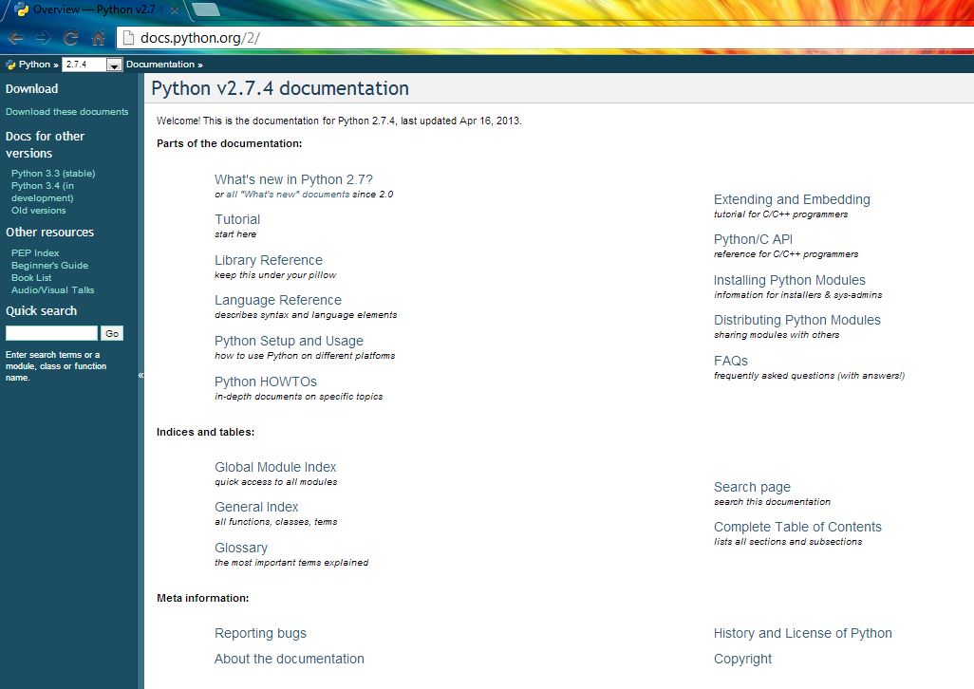
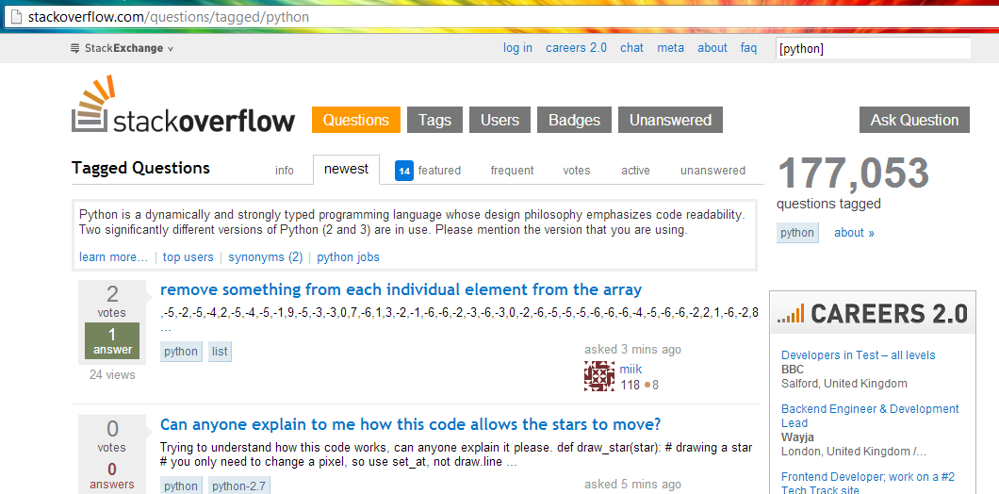
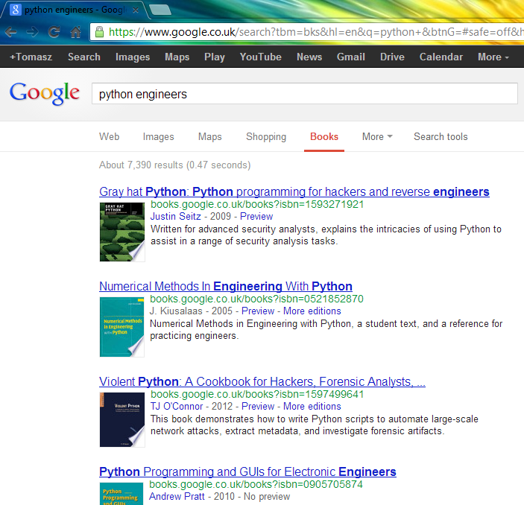
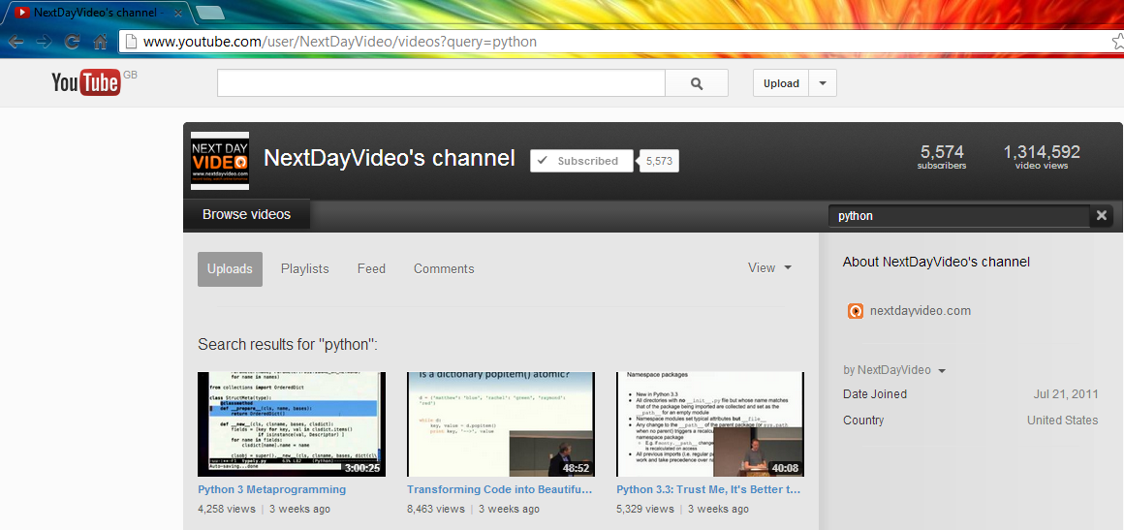
Where to get help
Official Python documentation
Python community
PyCon and video tutorials
Many books and tutorials

Slide 6
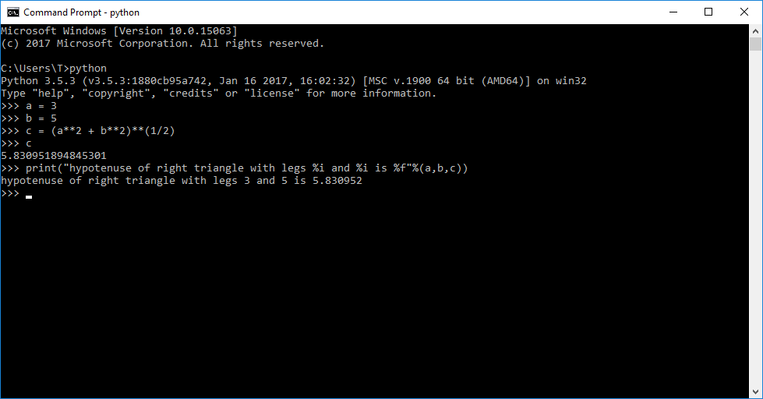
Python as the bare language
Python has a design philosophy which emphasizes code readability (notably using whitespace indentation to delimit code blocks rather than curly brackets or keywords), and a syntax which allows programmers to express concepts in fewer lines
In windows open cmd and type in python

Slide 7
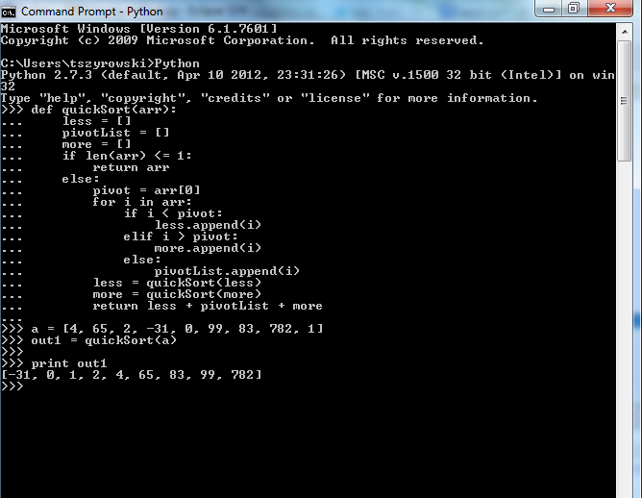
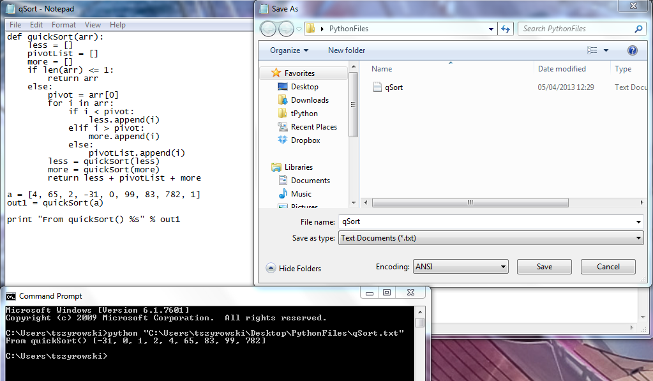
How to use Python
The Cmd class provides a simple framework for writing line-oriented command interpreters.
Python scripts have to be processed by another program called the Python interpreter. The interpreter reads a script, compiles it into bytecodes, and then executes the bytecodes to run a program.
On Windows, the standard Python installer already associates the .py extension with a file type (Python.File) and gives that file type an open command that runs the interpreter .
This is enough to make scripts executable from the command prompt as ‘foo.py’.
http://www.python.org/

Slide 8
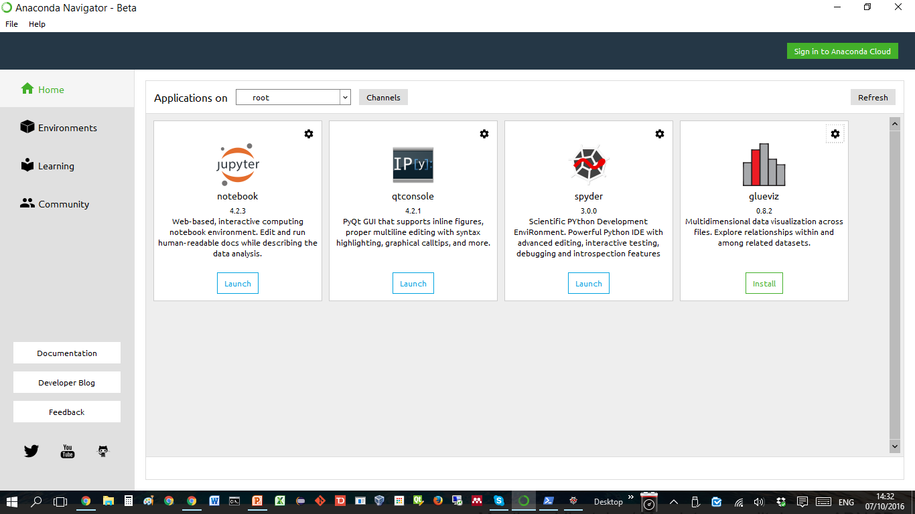
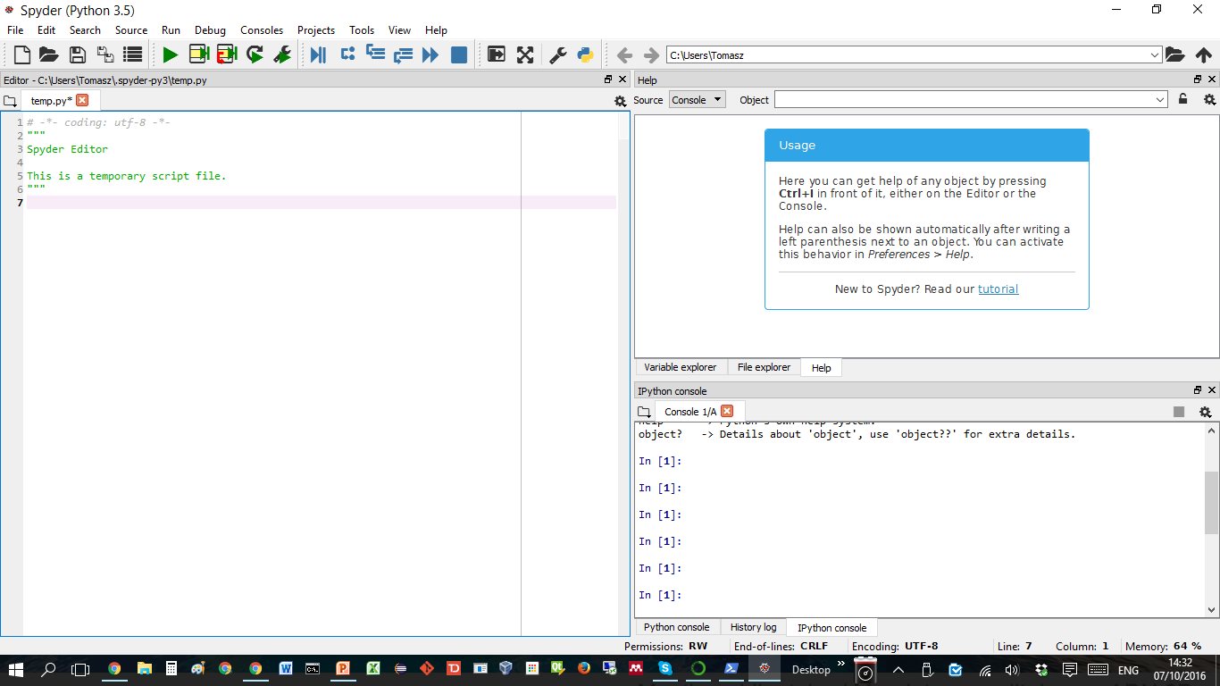
Python Integrated Development Environment, Anaconda and Spyder

Slide 9
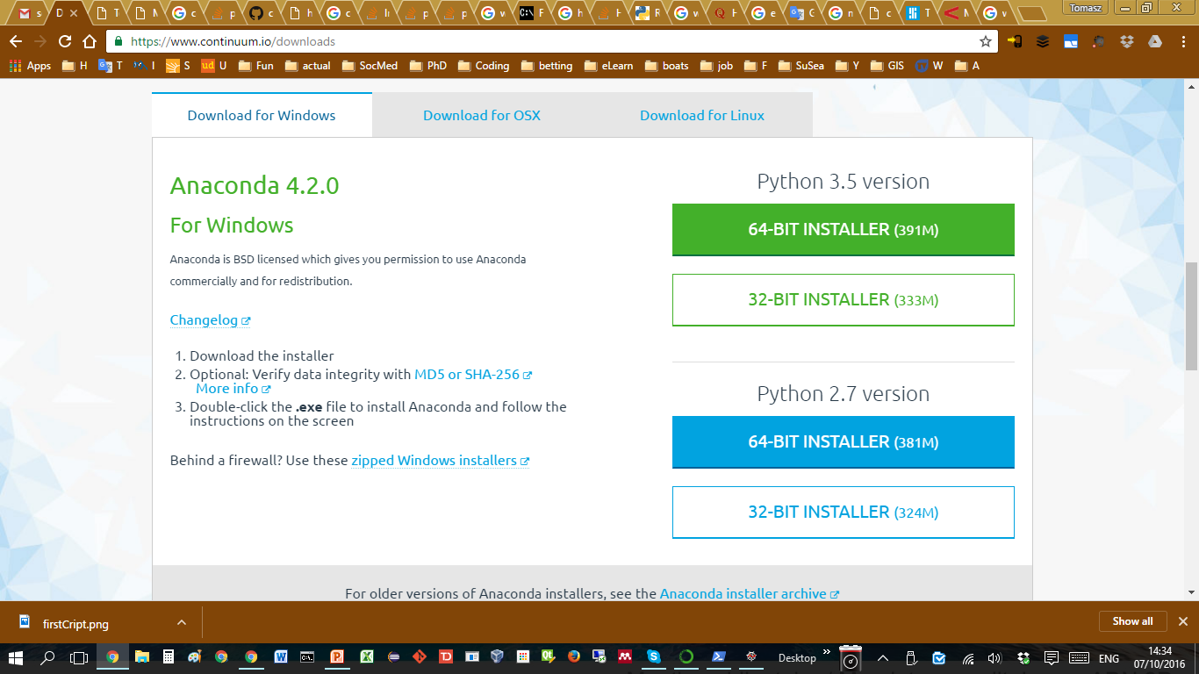
Installing Anaconda

Slide 10
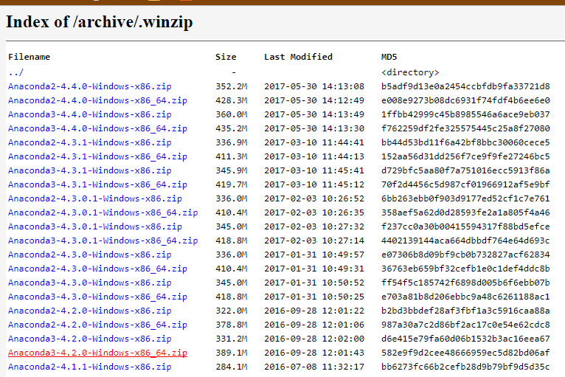
Bleeding edge can bleed you out
We are installing: Anaconda3-4.2.0-Windows-x86_64

Slide 11


On side info:
USE VERSION CONTROL
Git is one of the version control.
It allows you to keep your projects in the cloud
It shows you changes history
It allows you to collaborate
It is free!
It is very, very good practice
…and more
https://github.com/tszyrowski/workshops

Slide 12
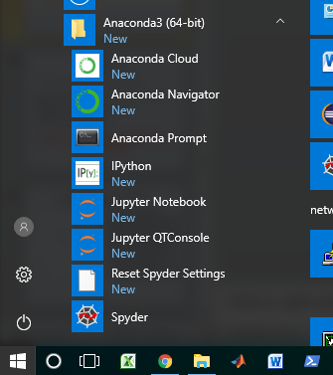
Anaconda – one of many environments
User level install of the of python you want
Able to install/update packages completely independent of system libraries or admin privileges
conda tool installs binary packages, rather than requiring compile resources like pip - again, handy if you have limited privileges for installing necessary libraries.
Eliminates the headaches of trying to figure out which version/release of packages are compatible with which each other
Comes either in full-meal-deal version, with numpy, scipy, PyQt, spyder IDE, etc. or in minimal / alacarte version (miniconda) where you can install what you want, when you need it
No risk of messing up required system libraries

Slide 13
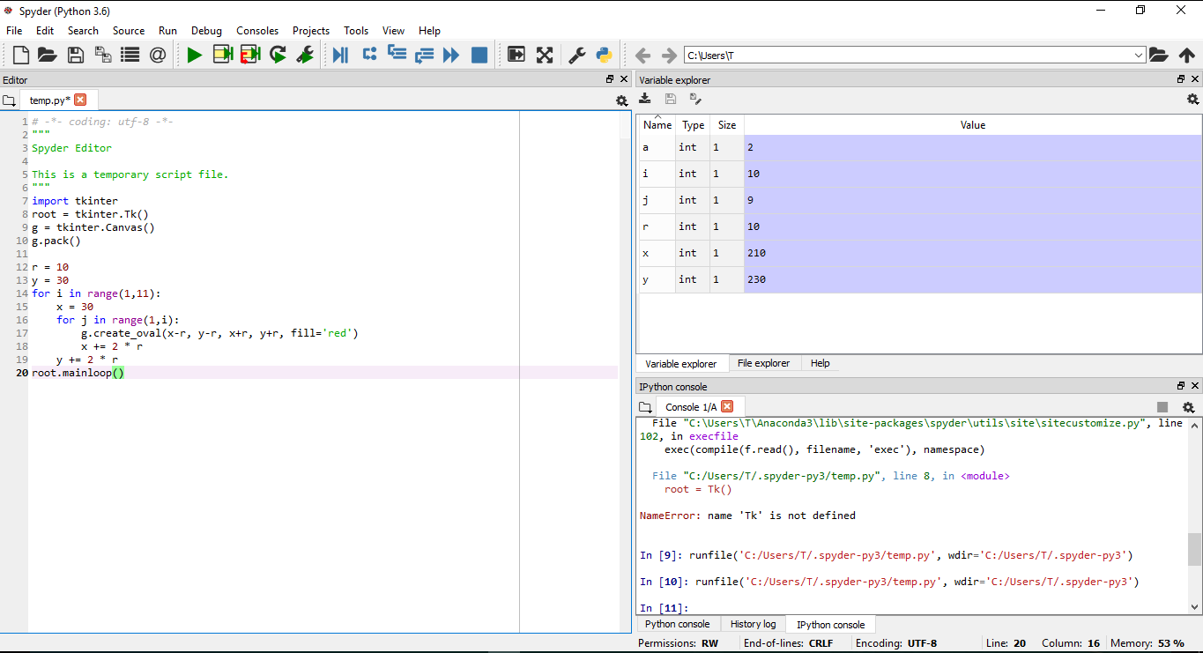
Although great, IDE is not the lenguage
Variable/file
explorer
Editor pane
Console

Slide 14
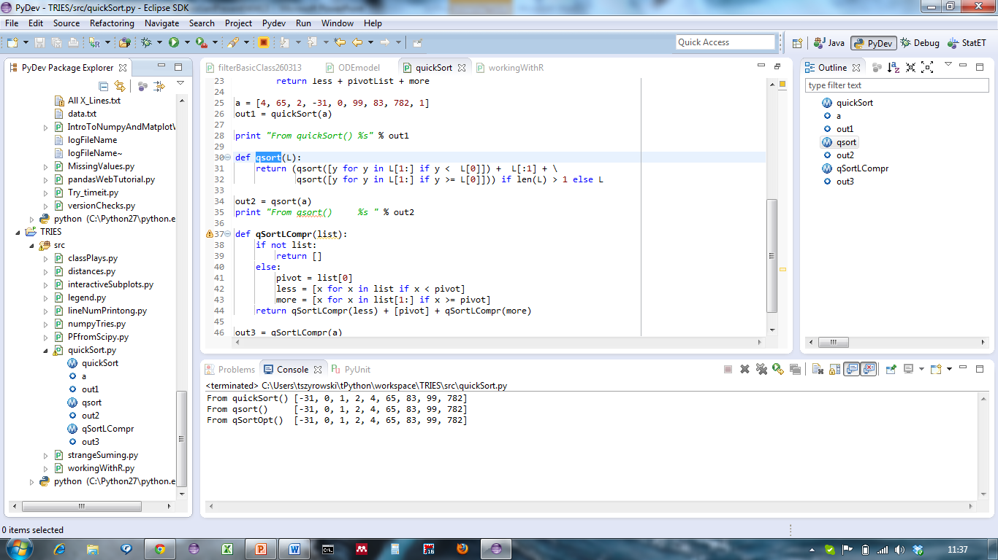
PyDev / Eclipse - IDE
http://pydev.org

Slide 15
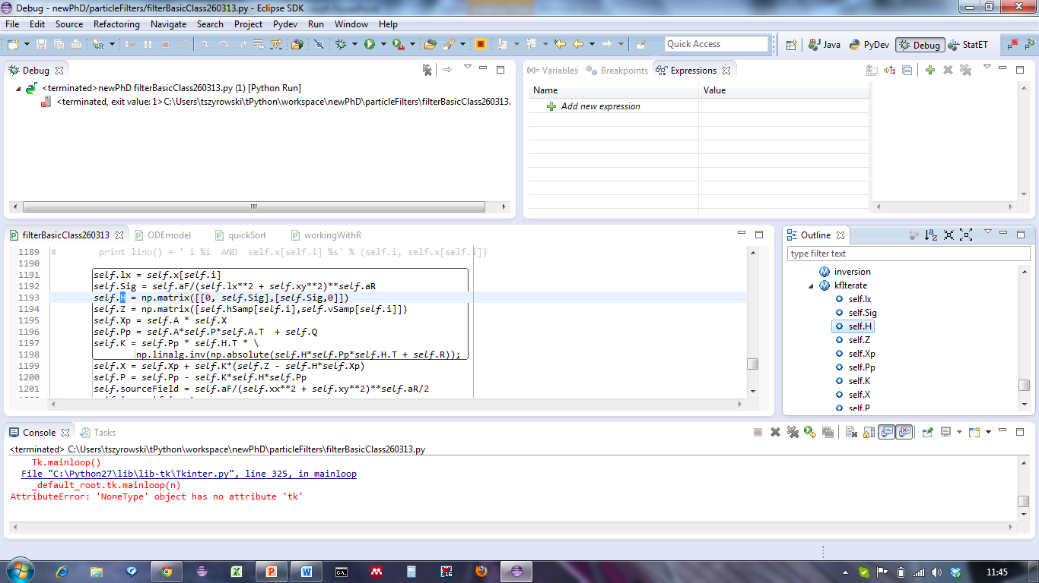
PyDev / Eclipse - Debugging

Slide 16
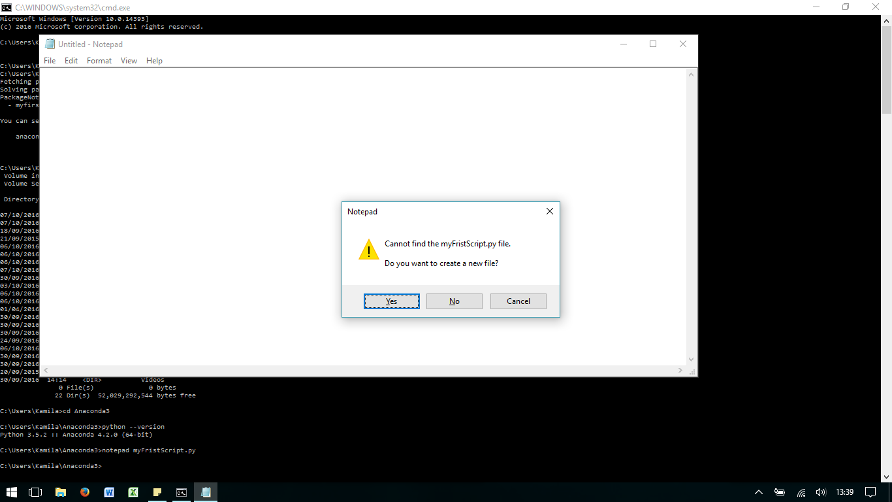
“Hello World” from command line
Python can be used as a stand alone program run from the command line or packaged into .exe as any other program
Navigate to Anaconda3 folder >cd C:\Users\...\Anaconda3
Check Python version >python –version
Create simple file >notepad firstScript.py
Write your first program print(“Hello World”)
Execute the program >python firstScript.py

Slide 17
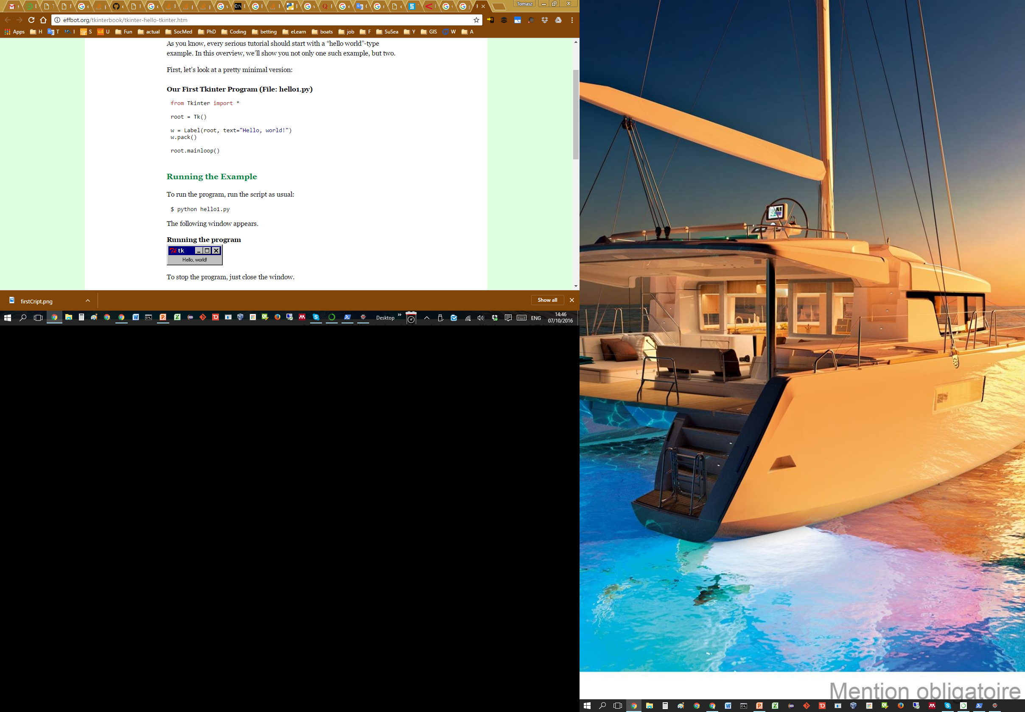
Let’s pretend we are Genius !
INSTRUCTION:
Create file heelo1.py in notepad, save into a folder ~\Documents
Open cmd with python 2.7, type:
python ~\Documents\hello1.py
Open cmd with python 3.x type:
python ~\Documents\hello1.py

Slide 18
ERROR ?!?!
I don’t want to scare you but be prepared
Python has two different versions as Python 2 (2.7) and Python 3 (3.5)
The difference are subtle, for example in
In Python 2 we import Tkinter
In Python 3 we import tkinter
Always read Error message and don’t be afraid to debug

Slide 19
What Happened ?#’?//
We start with importing additional library which contains all classes, functions and other things need for out programme
We initialise library and create a widget which is a main window
Inside the main window we create a Label and size this label with .pack() function.
The programme will not appear until we have call it to apear. In this case it is Tkinter event loop

Slide 20
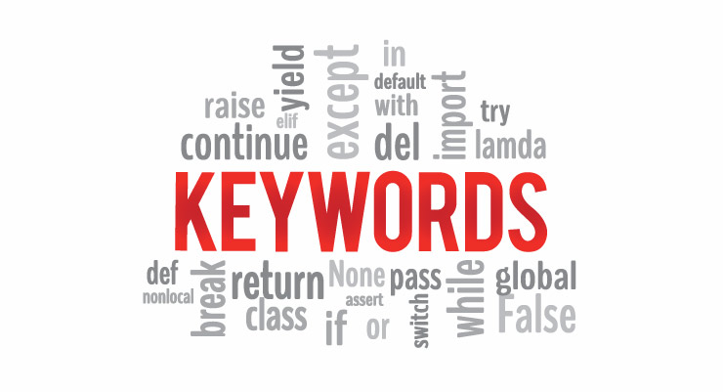
How much Python is in Python?
Keywords in Python programming language
False | class | finally | is | return
None | continue | for | lambda | try
True | def | from | nonlocal | while
and | del | global | not | with
as | elif | if | or | yield
assert | else | import | pass
break | except | in | raise
The above 33 keywords may get altered in different versions of Python.

Slide 21
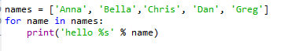

So where the programming is? Repetition and decisions:
Loops and Conditions
Data types
Lists
Strigs
- indentation

Slide 22
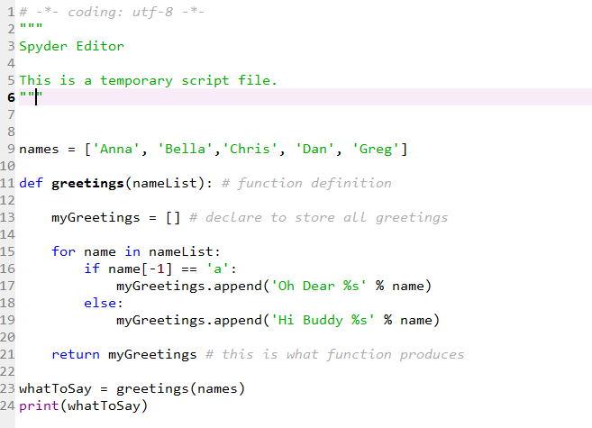
Let’s start for real: Functions!

Slide 23
Let’s get something more fun
import tkinter as tk # getting GUI library (module)
root = tk.Tk() # create main application structure (class)
g = tk.Canvas() # create place to draw things in
g.pack() # place canvas inside application
r = 10 # create radius of a ball
y = 30 # y-coordinate
colors = ['red', 'green', 'blue'] # list of colours to use
for i in range(1,11): # main (outside) loop
print(i)
x = 30
for j in range(1,i): # second (inner) loop
if i < 4: # execute for first loops
g.create_oval(x-r, y-r, x+r, y+r, fill=colors[0])
elif 4 < i < 9: # execute middle loops
g.create_oval(x-r, y-r, x+r, y+r, fill=colors[1])
else: # all else
g.create_oval(x-r, y-r, x+r, y+r, fill=colors[2])
x += 2 * r # move x-coordinate
y += 2 * r # move y-coordinate
root.mainloop() # execution application
Another example of loop and conditions

Slide 24
Check for module
We are looking for Anaconda prompt
conda (list packages)
We are looking for pyinstaller
Alternatively : pyinstaller --version
To install this package with conda run: conda install -c acellera pyinstaller=3.2.3
or
pip install pyinstaller

Slide 25
Create executable
Navigate to the folder with your script.py
You can check if pyinstaller is in the path : pyinstaller --version
Run pyinstaller with script you want to compile: pyinstaller myScript.py
The program will create a folder __pycache__ inside the folder is executable
pyinstaller can be run with different options. For reference please see:
https://pythonhosted.org/PyInstaller/usage.html

Slide 26
Challenge !?!?
Create executable file
as a single .exe file
running without a cmd in the background

Slide 27
A word about errors
If you installed Anaconda 4.4 with Python 3.6 you run into troubles.
pyinstaller is not yet compatible with Python 3.6
If you run it from the console you may get an error:
File "c:\users\anaconda3\lib\site-packages\PyInstaller\lib\modulegraph\modulegraph.py", line 2731, in get_operation_arg_name
return module_code_object.co_names[co_names_index]
IndexError: tuple index out of range
Search for it . It should take you to a forum thread stating about non-compatibility.
DON’T AFRAID OF ERRORS

